Slide 1
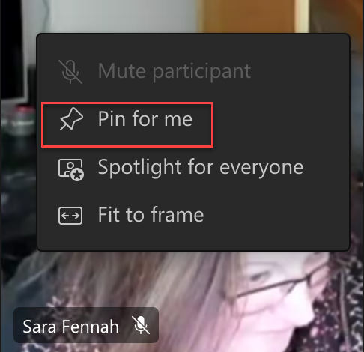
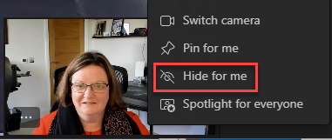
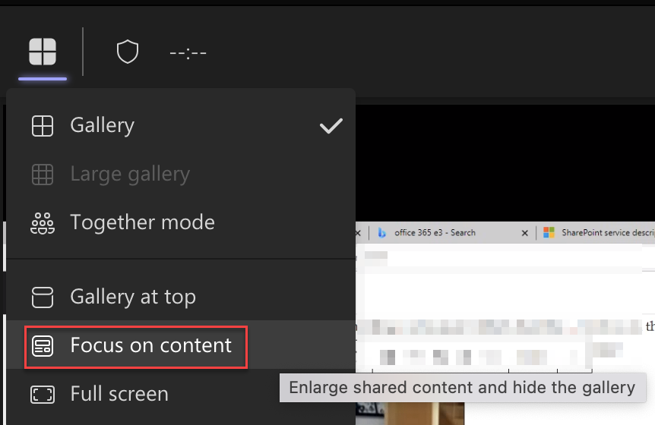
Keeping Your Focus
Method 1: Hide your own video
Method 2: Hide everyone else’s
(except the presenter)
Notes:
See also: Keeping your Focus in Meetings – The Teams Queen Blog https://teamsqueen.com/2022/01/27/keeping-your-focus-in-meetings/
Method 1: To help keep your focus, you can hide your own video in Teams so you do not have to watch yourself all day
Method 2: Pin the presenter video then focus on the content to switch off all other attendees videos.

